Slide 1


Solving equations with fractional coefficients
Sometimes the coefficient of an unknown is a fraction. For example,
3
x – 5 = 9 – x
4
We can remove the 4 from the denominator by multiplying both sides of the equation by 4.
3
4( x – 5) = 4(9 – x)
4
expand the brackets:
3x – 20 = 36 – 4x
add 4x to both sides:
7x – 20 = 36
add 20 to both sides:
7x = 56
divide both sides by 7:
x = 8
Notes:
Explain that we multiply by the number in the denominator to cancel it out.
Point out that ³/₄ x can also be written as ^{3x}/₄.
Ask pupils to check the solution by substituting x = 8 into the original equation.

Slide 2
Solving equations with fractional coefficients
If an equation contains more than one fraction these can be removed by multiplying throughout by the lowest common multiple of the two denominators. For example,
2
1
x = x + 1
3
2
What is the lowest common multiple of 3 and 2?
The lowest common multiple of 3 and 2 is 6. Multiplying both sides by 6,
2
1
6( x) = 6( x + 1)
3
2
expand the brackets:
4x = 3x + 6
subtracting 3x from both sides:
x = 6
Notes:
Talk through the multiplication of each term by 6. for example we can think of 6 × ²/₃ as 6 × 2 ÷ 3 or as 6 ÷ 3 × 2.

Slide 3
Solving equations involving division
In this example the whole of one side of the equation is divided by 5.
2x + 7
= x – 1
5
To remove the 5 from the denominator we multiply both sides of the equation by 5.
2x + 7 = 5(x – 1)
expand the brackets:
2x + 7 = 5x – 5
swap sides:
5x – 5 = 2x + 7
add 5 to both sides:
5x = 2x + 12
subtract 2x from both sides:
3x = 12
divide both sides by 3:
x = 4
Notes:
Talk through the equation on the board. Explain that when we have (2x + 7)/ 5 the dividing line acts as a bracket – that means that we add before we divide. To undo this, then we must start by multiplying by 5. If we multiply the left hand side by 5 we must also multiply the right hand side by 5.

Slide 4
Solving equations involving division
When both sides of an equation are divided by a number we must remove these by multiplying both sides by the lowest common multiple of the two denominators. For example,
5x – 3
2x – 1
=
4
3
What is the lowest common multiple of 4 and 3?
The lowest common multiple of 4 and 3 is 12. Multiplying every term by 12 gives us:
3
4
12(5x – 3)
12(2x – 1)
=
4
3
1
1
which simplifies to: 3(5x – 3) = 4(2x – 1)

Slide 5
Solving equations involving division
We can then solve the equation as usual.
3(5x – 3) = 4(2x – 1)
expand the brackets:
15x – 9 = 8x – 4
add 9 to both sides:
15x = 8x + 5
subtract 8x from both sides:
7x = 5
5
divide both sides by 7:
x =
7
Although this answer could be written as a rounded decimal, it is more exact left as a fraction.

Slide 6
Solving equations involving division
5x – 3
2x – 1
=
We have seen that
4
3
simplifies to 3(5x – 3) = 4(2x – 1)
How could we perform this simplification in one step?
Multiplying both sides by 4 cancels out the 4 on the left hand side and multiplies the expression on the right hand side by 4.
Multiplying both sides by 3 cancels out the 3 on the right hand side and multiplies the expression on the left hand side by 3.
Doing this in one step in often called cross multiplication.
Notes:
Cross multiplication is an efficient way to rearrange an equation or formula in this form. Make sure that pupils understand why it works in terms of doing the same thing to both sides of the equation.

Slide 7
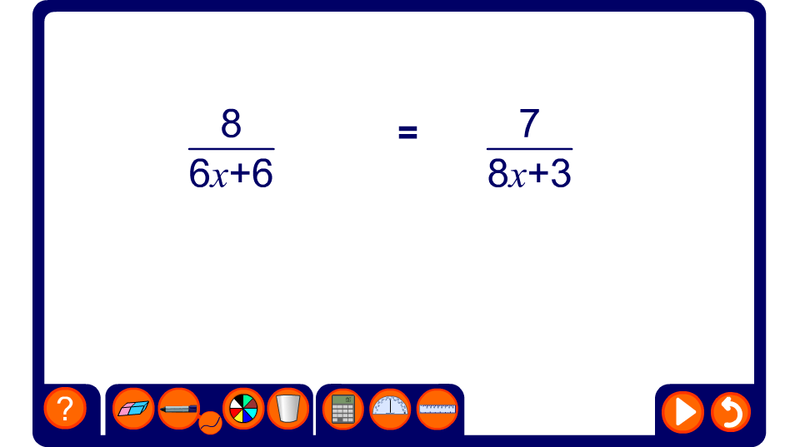
Simplifying equations by cross-multiplication

Slide 8
Solving equations involving division
Sometimes the unknowns appear in the denominator.
For example,
4
5
=
(x + 3)
(3x – 5)
In this example, we can multiply both sides by (x + 3) and (3x – 5) in one step to give:
4(3x – 5) = 5(x + 3)
expand the brackets:
12x – 20 = 5x + 15
subtract 5x from both sides:
7x – 20 = 15
add 20 to both sides:
7x = 35
divide both sides by 7:
x = 5
Notes:
Talk about the equation on the board. Explain that when we have (3x + 2)/ 4 the dividing line acts as a bracket – that means that we add before we divide. To undo this, then we must start be multiplying by 4. If we multiply the left hand side by 4 we must also multiply the right hand side by 4.
Ensure that all pupils are happy with this step before moving on to solve the equation.

Slide 9

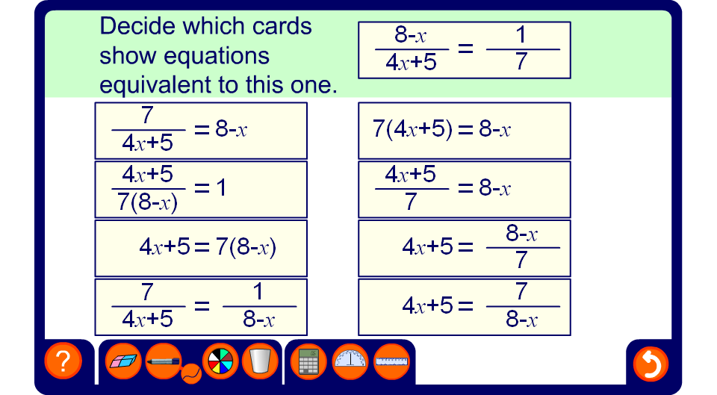
Equivalent equations
Notes:
Ask pupils to tell you which equations they believe to be equivalent to the one in the question.
Clicking on an expression will reveal whether of not it is equivalent to the required expression. Each time an equivalent expression is found ask pupils to tell you what has been done to both sides of the equation to make the selected equivalent expression.
Ask pupils to tell you which form of the equation is the easiest to solve (the form with no denominators).
Ask pupils to solve the equation in the window and substitute this solution into the equivalent equations found to verify the solution.

